Slide 1
FORGIVENESS AS A KEY TO SUCCESS
By Regina A. DeMeo, Esq.
1666 Connecticut Ave, NW
Suite 250
Washington, DC 20009
(240)621-0559
www.reginademeo.com
© Regina A. DeMeo, Esq.

Slide 2
Forgiveness- what it is not:
It is NOT about forgetting;
It is NOT excusing the behavior;
It is NOT about becoming vulnerable;
It is Not necessarily about continuing a relationship.

Slide 3
What is forgiveness?
It is a process of letting go;
It is multi-layered;
It is an individual choice;
It is necessary to finding peace;
It is a key component of love; and
It is a gift– mainly to yourself.

Slide 4
Three steps towards forgiving:
Identify the source of anger/pain.
Try to understand a person’s motives or intent.
Weigh options & find a workable solution.

Slide 5
The 3 Ws to Forgiveness:
WHO hurt/disappointed you?
Family, friend, colleague, stranger
WHAT was the transgression?
Agreement breached or
expectations not met
WHY did this happen?
Break in communication, misunderstanding,
cluelessness or intentional

Slide 6
Why is it so hard to forgive?
It is a complicated emotional process;
It requires an open mind & open heart;
Inspiration is key;
Our litigious society promotes win-lose view;
Sink or swim mentality is prevalent;
Darwin’s “survival of the fittest” motto;
Forgiveness is seen as sign of weakness or foolishness.

Slide 7
Reasons to Forgive:
We need each other to survive;
Negativity attracts negativity;
Angry people repel others;
Harboring resentment makes people ill;
People stuck in the past cannot move forward;
Successful people (professionally and personally) turn their pain into source of strength.

Slide 8
The challenge for type As:
We are intense personalities;
We strive for excellence;
We want to succeed/win;
We are driven, goal-oriented & focused;
We are argue persuasively;
We are gamers & great strategists;
We tend to be independent, self-reliant and have control tendencies.

Slide 9
Some points to consider:
Intense personalities are not the majority;
75% of the U.S. population do not have a 4-year college degree;
Only 15% of the U.S. population have graduate degrees;
Most people work to live, they don’t live to work;
Lack of communication & understanding are key reasons for conflict.

Slide 10
Re-tooling our thinking
Instead of win-lose model, try and find the win-win in a situation;
Try to appreciate different perspectives & adopt more of a team approach to finding solutions;
Accept that no one is perfect, and sometimes 95% is good enough;
Have realistic expectations- can’t expect a fish to climb a tree;
Can’t control everything- life simply won’t follow our plans 100% of the time;
Just because someone hurts us, doesn’t mean we need to lash back.

Slide 11
My own journey towards finding forgiveness…
‘70s.. FL court dismissed paternity case;
‘80s.. National gymnast & AGO scholar without dad;
‘90s.. Came to Georgetown University, SFS;
1998- Graduated GW Law;
2005- Divorce led to different approach to family law;
2006- Trained as Mediator & Collaborative Professional;
2009- President of CDA, Inc., began lectures in DC;
2010- Wash Post, ABA articles and ABC tv;
2011-Family reunion.

Slide 12
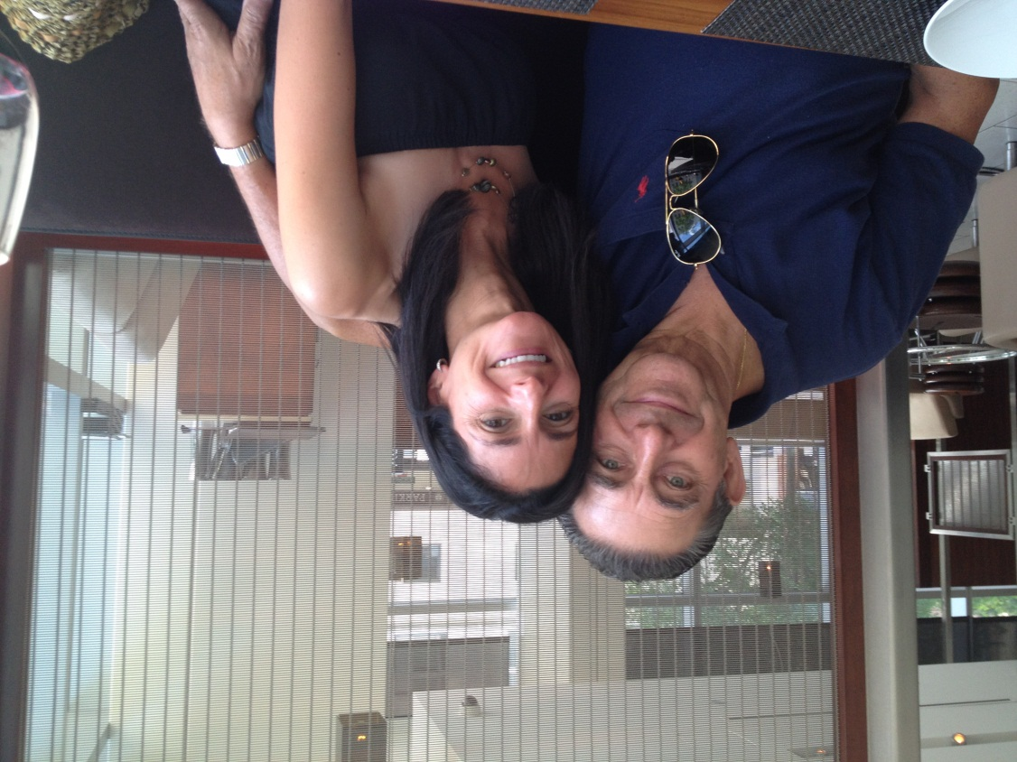
The Power of Forgiveness

Slide 13
© Regina A. DeMeo, Esq.
Dedicated to the Vila Family

